Slide 1


PICK AND PLACE ROBOTIC ARM
Term project submitted for the Course : Mechatronics laboratory(ME69036)
Involves the application of ARDUINO, Color detecting sensor and Motors.
Submitted to:
Professor ARUN KUMAR SAMANTARAY
PROFESSOR mihir SARANGI
Professor Cheruvu siva kumar
Submitted By:
SREERAG V (21RJ92R02)
GOBIND KUMAR (21ME63R36)
VAIBHAV TYAGI (21ME63R37)
ALLAM VINAY NAGENDRA RAMTARUN (21ME63R39)
KESHAVA G (21ME63R40)
KOMATI REDDY NITHIN REDDY (21ME63R41)

Slide 2

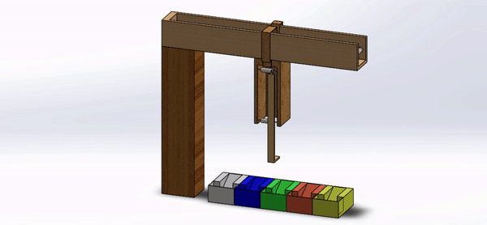
Basic Idea of the project
A pre-programmed Robotic arm controlled with an Arduino, picks a user specified colored ball among different balls, with the help of color detecting sensor, and places it near the user.

Slide 3

Objectives of our project
Understanding the working principles and programming methods of:
Color detecting sensor
Stepper motor
Servo motor
Developing a C++ code to establish a sync between Color detecting sensor, Stepper motor and servo motor.
Creating the circuit connections in order to establish the sync physically in the assembly.
Projecting our basic idea as clear as possible with a physical assembly involving procurement of necessary materials, design, teamwork and understanding the non- technical aspects of the project.

Slide 4

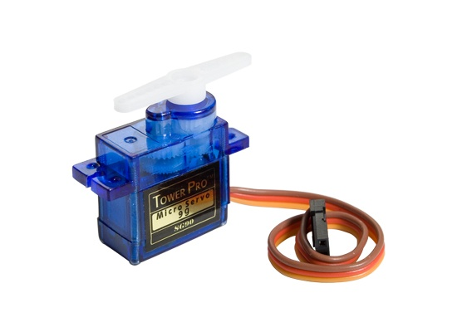
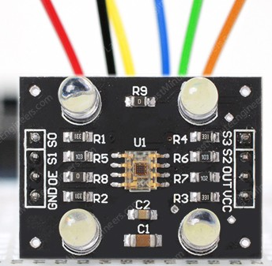
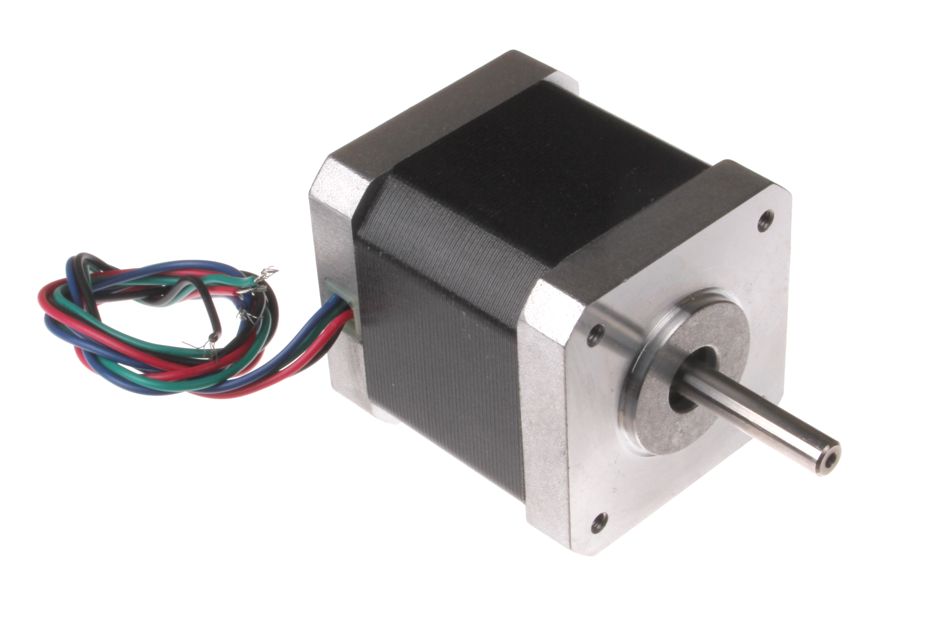
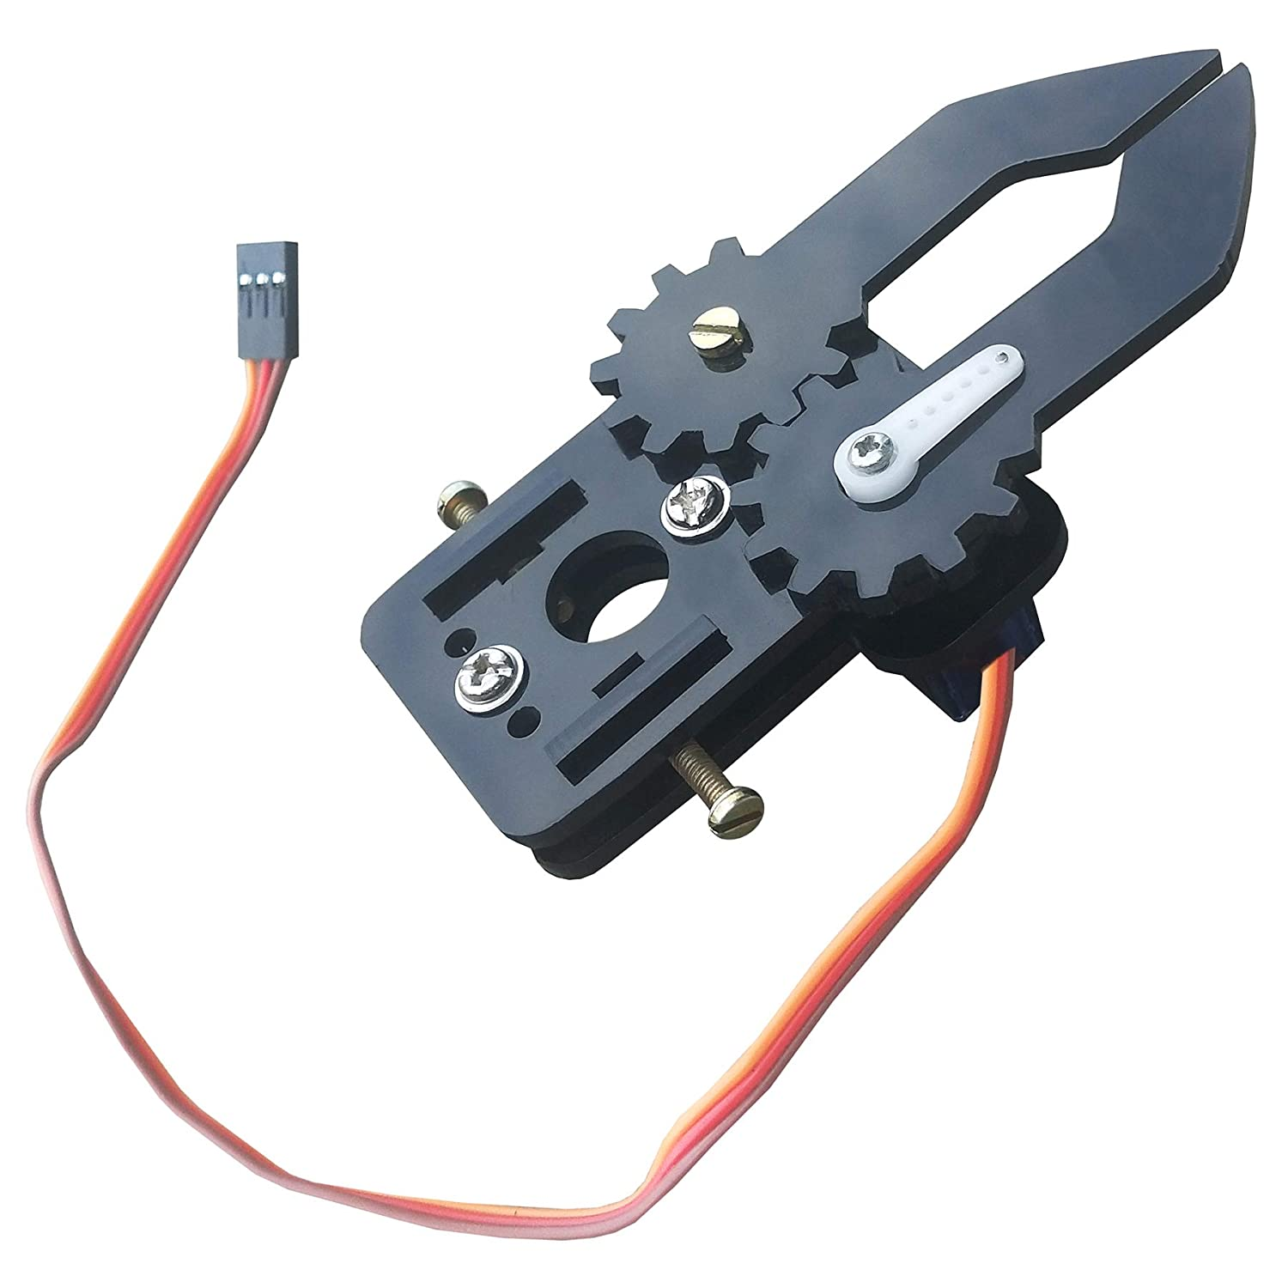
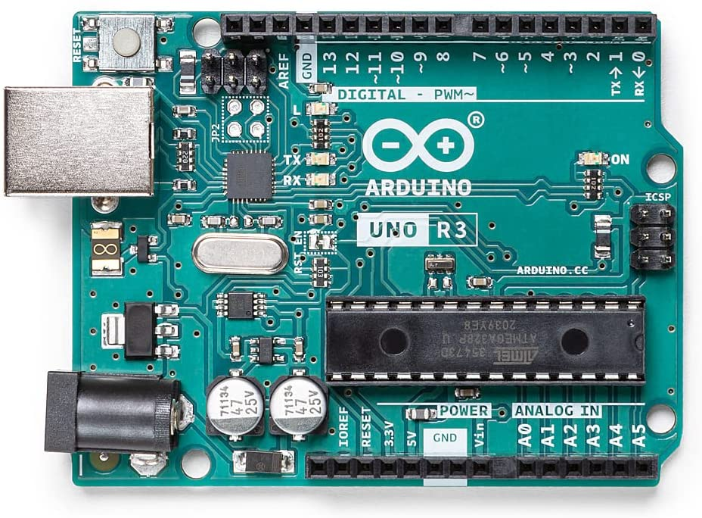
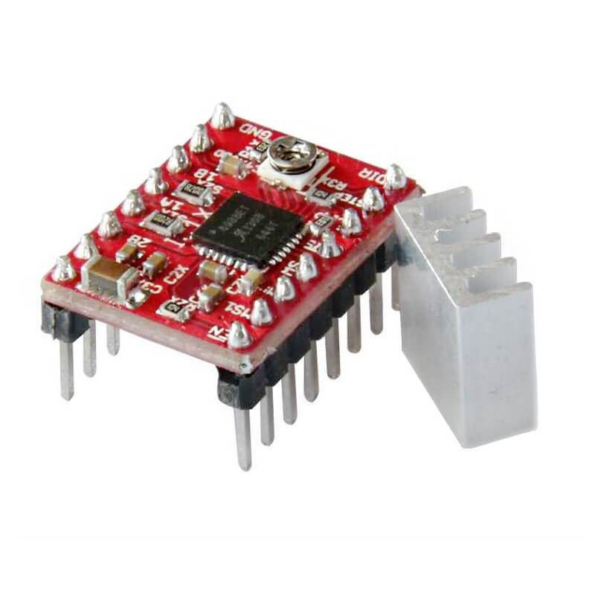
Major components
TCS 3200 colour detecting sensor
Stepper motor
Servo motor
Arduino UNO board
Driver module
Mechanical gripper
1.
2.
3.
4.
5.
6.

Slide 5
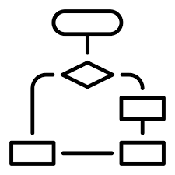
Flow chart
TURNS OFF SERVO MOTOR
STOP
START
DETECTS THE COLOUR AT ONE POINT
USER INPUT
(SPECIFIES THE COLOUR OF BALL TO BE PICKED)
CONTINUE RUNNING TILL THE COLOUR IS DETECTED
HOLDS THE BALL AND BRINGS IT TO PREDEFINED POSITION
NO
STEPPER MOTOR AND COLOUR SENSOR SWITCHES ON
CHECKS IF THE USER SPECIFIED COLOUR IS DETECTED
YES
TURNS ON SERVO MOTOR CONNECTED TO GRIPPER
TURNS OFF STEPPER MOTOR, SENSOR

Slide 6

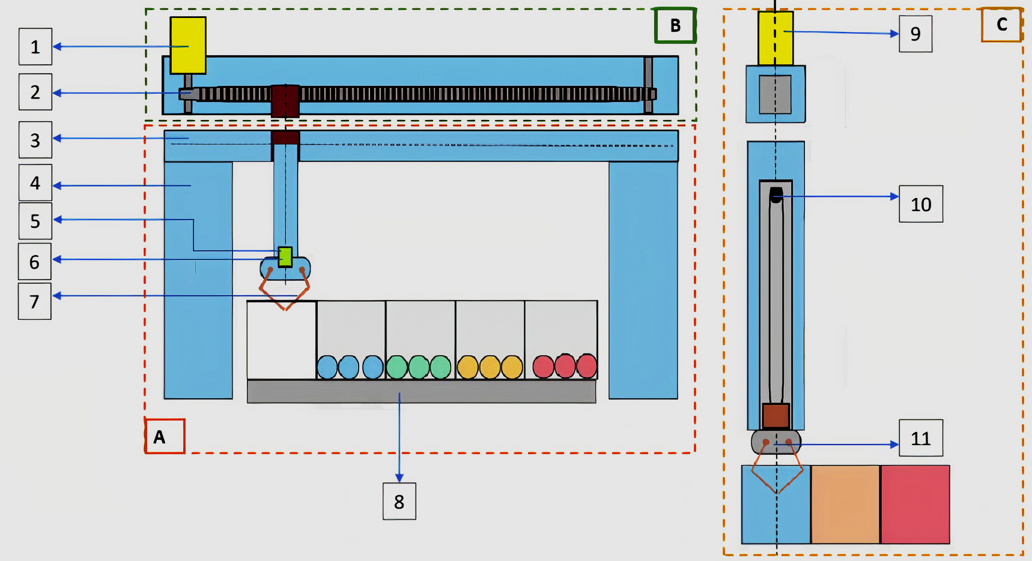
SCHEMATIC DIAGRAM
1. Primary motor: 9V DC motor | 2. Timing Belt and Pulley
3. Horizontal C section member | 4. Supporting member
5. Moving C section arm | 6. Colour detecting sensor
7.&11. Mechanical Gripper with servo motor | 8. Platform with Boxes containing Balls
9. Secondary Motor : 5V stepper motor | 10. Timing Belt and Pulley
A: Front view of the mechanism
B: Top view of the Horizontal C section
C: Enlarged view of Moving C section arm

Slide 7

Project WORK plan
Phase 1 (07-26 Feb)
Initiation and finalisation of Project idea for the term project.
4 Discussions through virtual meetings in MS teams, in the month of February.
Phase- 2 (01-11 March)
Working on the initial design, required components, circuit diagrams and coding work.
Procuring of components like cardboard, motors, sensor, timing belt and pulleys.
Phase 3 (21 March to 4th April)
Working on the Assembly
Phase 4 (April 9th)
Phase 3(a)
Final project review on 02nd April.
Phase 1(a)
First project review on 18th February.
Explained the status of the project.
5 Discussions through virtual meetings in MS teams, in the month of February.
Submitting the Final report along with demonstration of assembly with a presentation.
Finalising the code (https://github.com/Gobind147/Automated-Pick-and-Place-Mechanism)

Slide 8


WORK DISTRIBUTION
Collective initiation and development of idea by the team.
Designing the Circuit and Coding work involving:
Calibrating colour sensor: Nitin Reddy and Gobind kumar
User input: Sreerag V
Stepper and servo motors : AVN Ramtarun
Establishing sync between motors and sensor : Vaibhav Tyagi and Keshava G
Physical assembly:
Procurement of materials and components: Gobind kumar
Entire team collectively involved for assembling the parts and components for making the final working assembly.

Slide 9

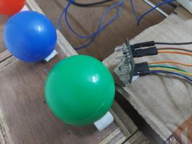
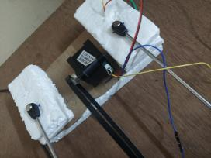
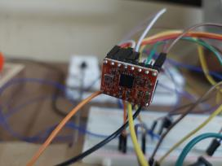
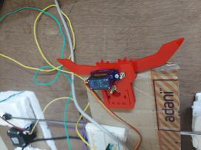
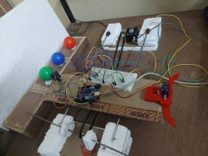
PHYSICAL COMPONENTS AND ASSEMBLY

Slide 10

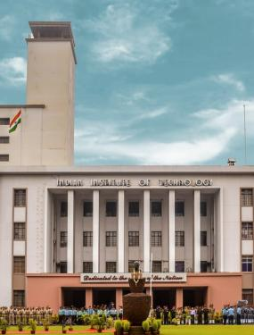
Sincerely thanking,
The professors :
ARUN KUMAR SAMANTARAY
mihir SARANGI
Cheruvu siva kumar
And ,
The Teaching assistants:
SAKSHAM KUMAR
NIKHIL ANAND
MALA MURALIDHAR

